Slide 1









ATAI
Advanced Techniqueof Artificial Intelligence
ATAI
ChongqingUniversity _{AdvancedTechniqueof}
of Technology Artificial Intelligence
Chongqing University of
Technology
Chongqing University ^{ATAI}
_{of Technology} Advanced Techniqueof
Artificial Intelligence
Chongqing University of Technology
Chongqing University of Technology
Frequency-Augmented Mixture-of-Heterogeneous-Experts
Framework for Sequential Recommendation
code: https://anonymous.4open.science/r/FamouSRec/
—— WWW 2025
Reported by ZhenDong Huang
1

Slide 2

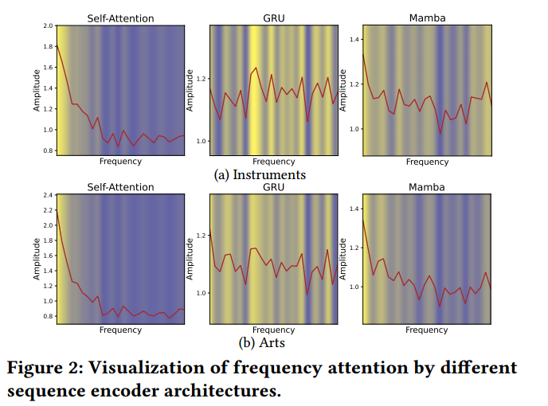
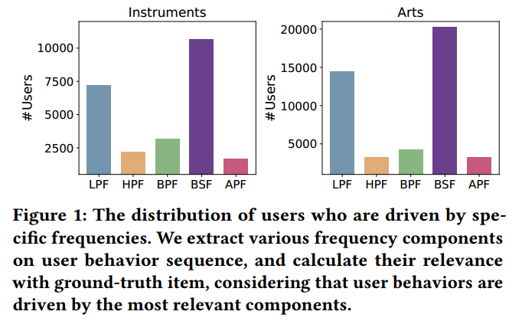
ATAI
AdvancedTechniqueof
Artificial Intelligence
ATAI
ChongqingUniversity _{AdvancedTechniqueof}
of Technology Artificial Intelligence
ChongqingUniversity of Technology
Motivation
1.users exhibit diverse behavioral patterns: some follow long-term preferences (low-frequency signals), while others are driven by high-frequency signals, makingshort-term interactions.
2.We find that different models tend to focus on particular frequency components, lacking comprehensive modeling of diversified frequencies

Slide 3

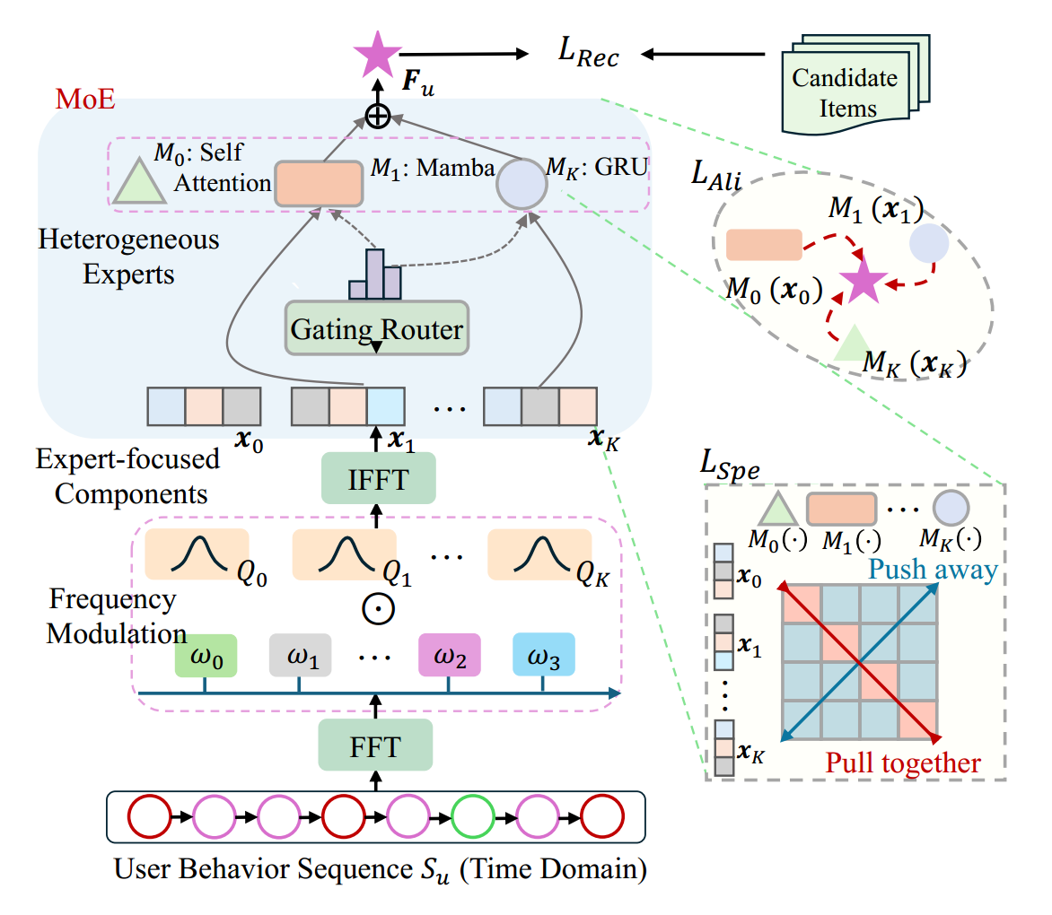
ChongqingUniversity of Technology
ATAI
AdvancedTechniqueof
Artificial Intelligence
ATAI
ChongqingUniversity _{AdvancedTechniqueof}
of Technology Artificial Intelligence
Overview

Slide 4



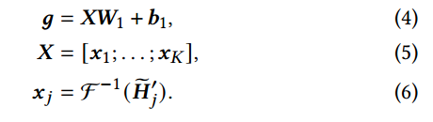
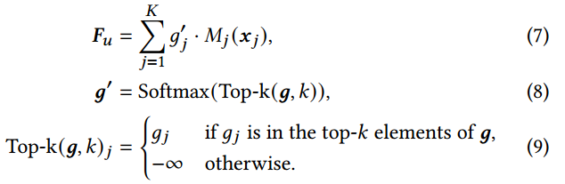
ChongqingUniversity of Technology
ATAI
AdvancedTechniqueof
Artificial Intelligence
ATAI
ChongqingUniversity _{AdvancedTechniqueof}
of Technology Artificial Intelligence
Method

Slide 5
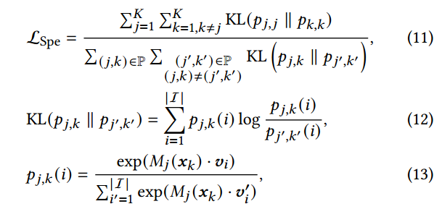

ChongqingUniversity of Technology
ATAI
AdvancedTechniqueof
Artificial Intelligence
ATAI
ChongqingUniversity _{AdvancedTechniqueof}
of Technology Artificial Intelligence
Method

Slide 6


ChongqingUniversity of Technology
ATAI
AdvancedTechniqueof
Artificial Intelligence
ATAI
ChongqingUniversity _{AdvancedTechniqueof}
of Technology Artificial Intelligence
Method

Slide 7

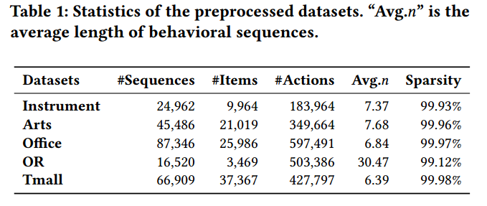
ATAI
AdvancedTechniqueof
Artificial Intelligence
ATAI
ChongqingUniversity _{AdvancedTechniqueof}
of Technology Artificial Intelligence
ChongqingUniversity of Technology
Experiments

Slide 8
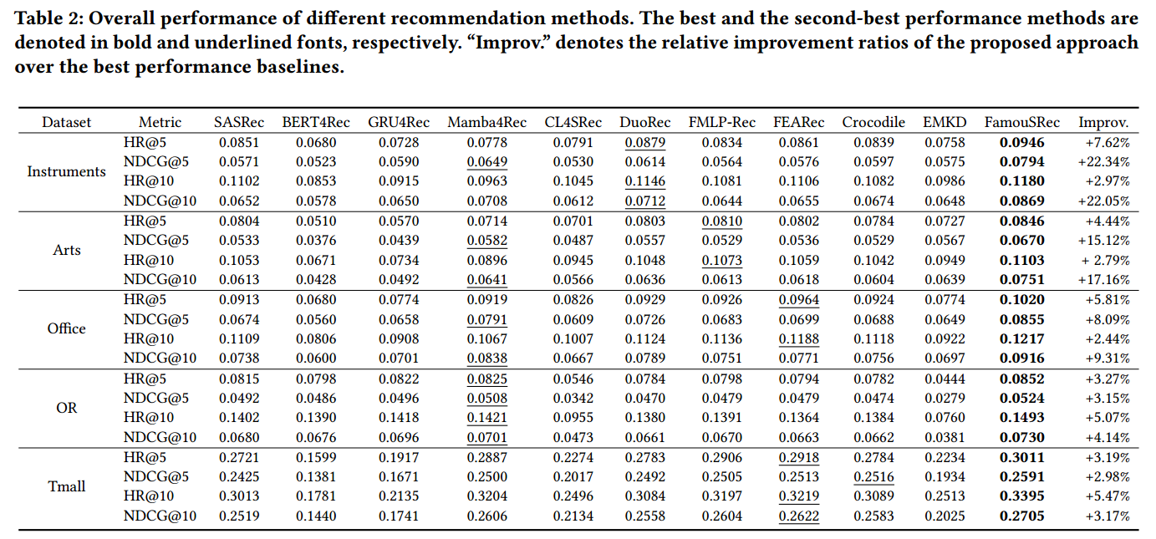
ATAI
AdvancedTechniqueof
Artificial Intelligence
ATAI
ChongqingUniversity _{AdvancedTechniqueof}
of Technology Artificial Intelligence
ChongqingUniversity of Technology
Experiments

Slide 9
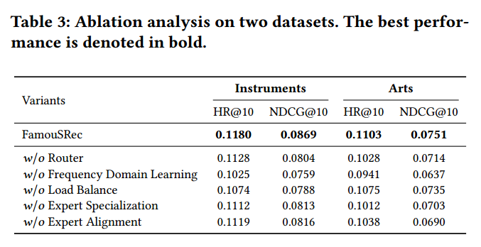
ATAI
AdvancedTechniqueof
Artificial Intelligence
ATAI
ChongqingUniversity _{AdvancedTechniqueof}
of Technology Artificial Intelligence
ChongqingUniversity of Technology
Experiments

Slide 10
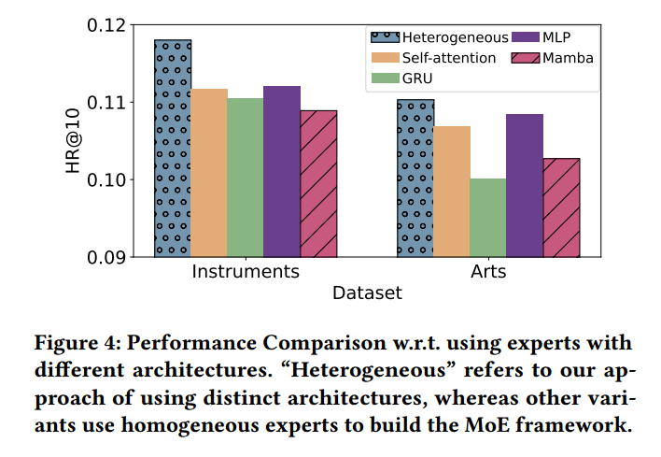
ATAI
AdvancedTechniqueof
Artificial Intelligence
ATAI
ChongqingUniversity _{AdvancedTechniqueof}
of Technology Artificial Intelligence
ChongqingUniversity of Technology
Experiments

Slide 11
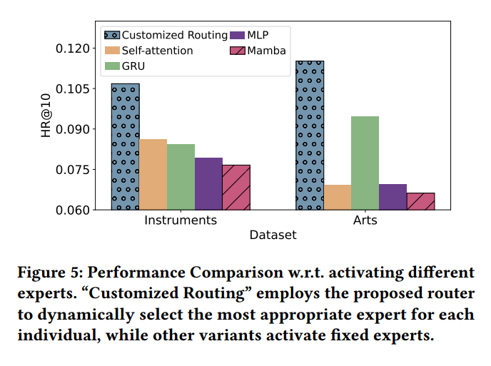
ATAI
AdvancedTechniqueof
Artificial Intelligence
ATAI
ChongqingUniversity _{AdvancedTechniqueof}
of Technology Artificial Intelligence
ChongqingUniversity of Technology
Experiments

Slide 12


ChongqingUniversity of Technology
ATAI
AdvancedTechniqueof
Artificial Intelligence
ATAI
ChongqingUniversity _{AdvancedTechniqueof}
of Technology Artificial Intelligence
Thanks!

